Slide 1
Mathematical Computing with Python
(NumPy)

Slide 2

Learning Objectives
By the end of this lesson, you will be able to:
Explain NumPy and its importance
Discuss the basics of NumPy, including its fundamental objects Demonstrate how to create and print a NumPy array
Analyze and perform basic operations in NumPy
Utilize shape manipulation and copying methods Demonstrate how to execute linear algebraic functions
Build basic programs using NumPy

Slide 3

Quick Recap: Lists
Below are some of the properties of lists:
List
Collection of values
Multiple types (heterogeneous) Add, remove, update

Slide 4
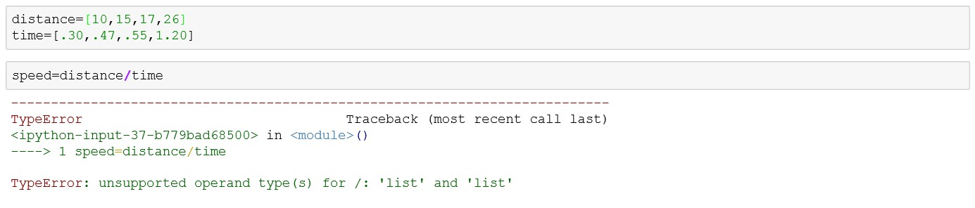
Limitations of Lists
You can change individual values in a list, but you cannot apply a mathematical operation over the entire list.
Mathematical operation over the entire “distance” and “time” lists
Error

Slide 5
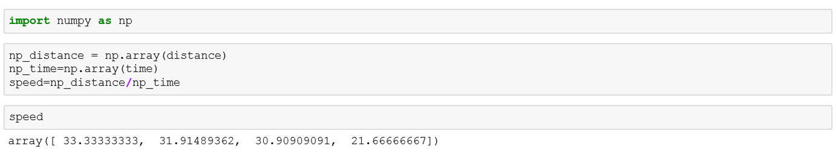
Why NumPy
Numerical Python (NumPy) supports multidimensional arrays over which you can easily apply mathematical operations.
Num py
26 | 43 | 52
Arra ys
like lis ts, but BETTER
Import NumPy
Create “distance” and “time” NumPy arrays
Mathematical function applied over the entire “distance” and “time” arrays
Output

Slide 6


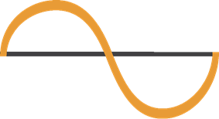




NumPy Overview
NumPy is the foundational package for mathematical computing in Python.
It has the following properties:
Supports fast and efficient multidimensional arrays (ndarray)
Executes element -wise computations and mathematical calculations
Performs linear algebraic operations, Fourier transforms, and random number generation
Tools for reading/writing array based datasets to disk
Efficient way of storing and
manipulating data
Tools for integrating language codes (C, C++)

Slide 7
Properties of ndarray
An array in NumPy has the following properties:
Collection of values
Multidimensional
Add, remove, change
ndarray
Mathematical function support
Single type (homogeneous)
Fast and efficient

Slide 8



Purpose of ndarray
The ndarray in Python is used as the primary container to exchange data between algorithms.
Algorithm
ndarray
[1, 2, 1]
Question/Problem
[[ 1, 0, 0],
[ 0, 1, 2]]
Data
Sharing
([[ 2, 8, 0, 6],
[ 4, 5, 1, 1],
[ 8, 9, 3, 6]])
Algorithm
Write Program
Algorithm

Slide 9
Types of Arrays
Arrays can be one -dimensional, two -dimensional, three -dimensional, or multi -dimensional.
One-Dimensional Array
Two-Dimensional Array
Three-Dimensional Array
Printed as rows
Printed as matrices (2x3)
Printed as list of matrices (3x3x3)
array([[[ 0, 1, 2],
[ 3, 4, 5],
[ 6, 7, 8]],
[[ 9, 10, 11],
[12, 13, 14],
[15, 16, 17]],
[[18, 19, 20],
[21, 22, 23],
[24, 25, 26]]])
array([5, 7,9])
1 axis
rank 1
arra y([[ 0, 1, 2],
[ 5, 6, 7]])
2 axes
rank 2
Length = 3
3 axes
rank 3
Le ngth = 3
5 | 7 | 9
0 (0,0) | 1 (0,1) | 2 (0,2)
5 (1,0) | 6 (1,1) | 7 (1,2)
y axis
0
1
x axis
2
y axis
Length = 3
x axis
z axis
x axis

Slide 10
Activity: Sequence it Right!
The code here is buggy. You must correct its sequence to debug it.
1
2
3
4

Slide 11
Activity: Sequence it Right!
1
2
3
4

Slide 12
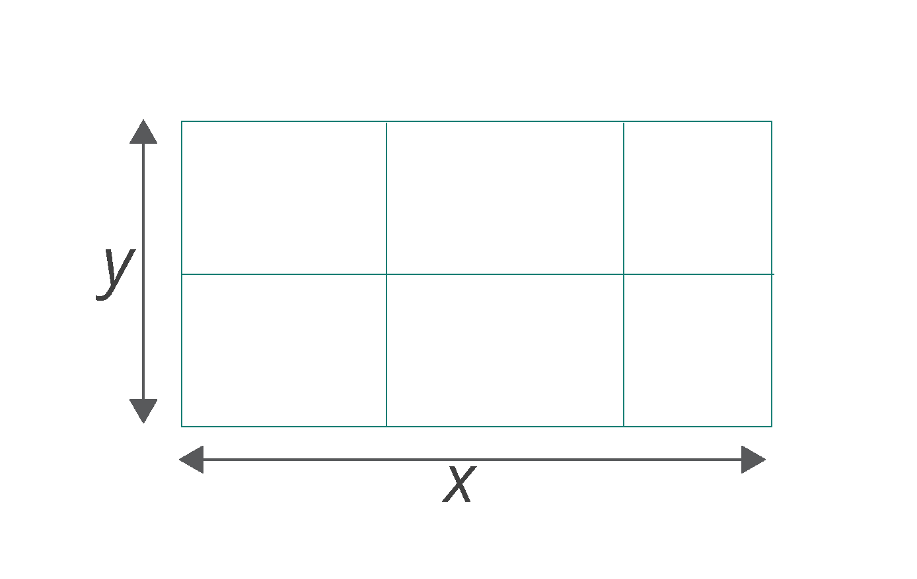
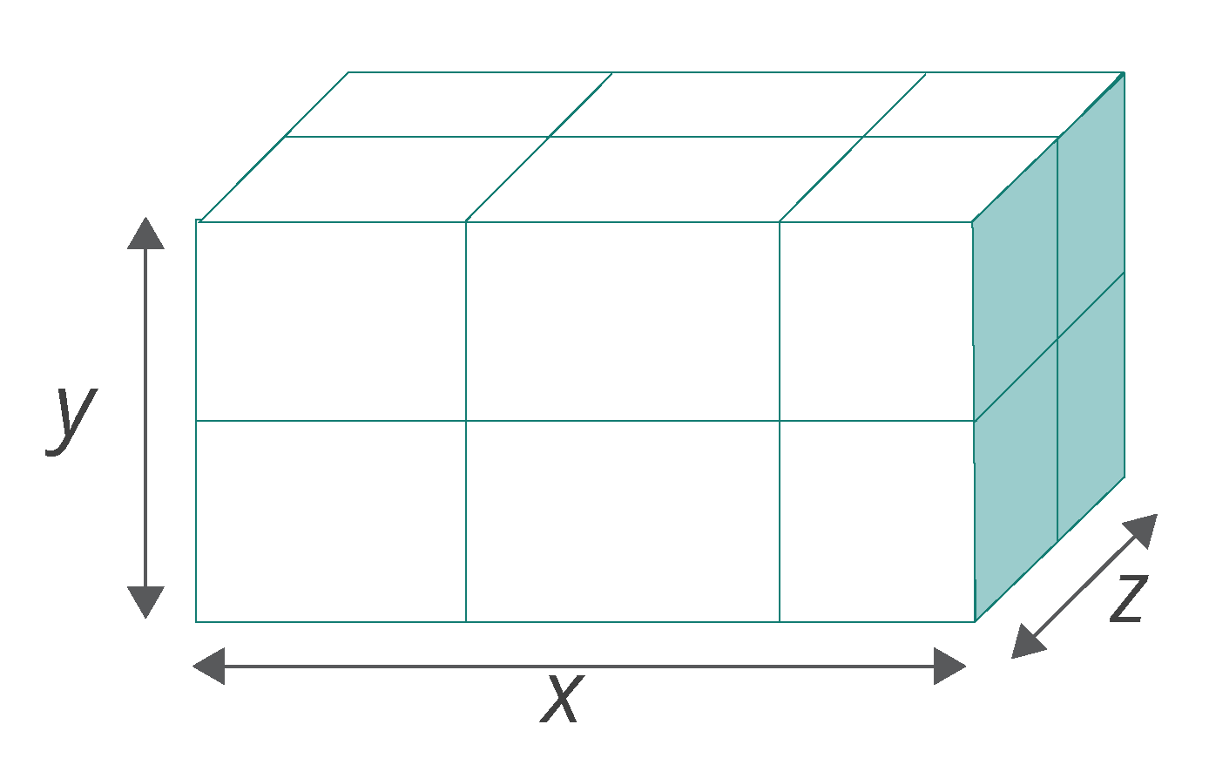
Classes and Attributes of ndarray: .ndim
Numpy’s array class is ndarray , also referred to as numpy.ndarray . The attributes of ndarray are:
This refers to the number of axes (dimensions) of the array. It is also called the rank of the array.
ndarray.ndim
ndarray.shape
ndarray.size
Two axes or 2D array
Three axes or 3D array
ndarray.dtype
Concept
Example

Slide 13
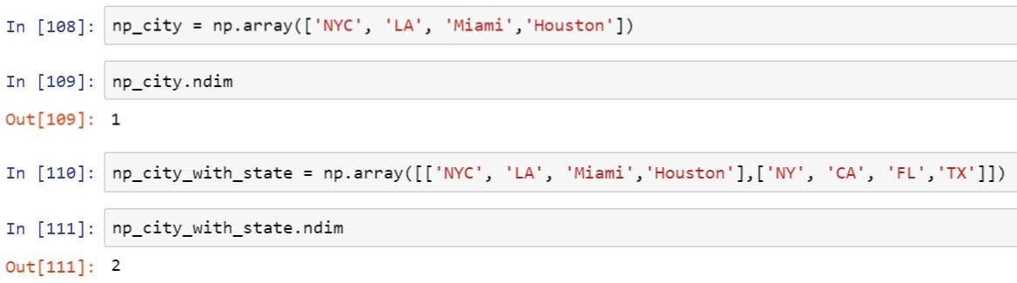
Classes and Attributes of ndarray: .ndim
Th e array np_city is one-dim ensiona l, while the array np_city_with_state
d im ens io na l.
is two-
ndarray.ndim
ndarray.shape
ndarray.size
ndarray.dtype
Concept
Example

Slide 14
Classes and Attributes of ndarray: .shape
Numpy’s array class is ndarray , also referred to as numpy.ndarray . Th e attrib utes of ndarray are:
Th is consists of a tup le of integers showing the size of the array in each d im ension. The length of the shape tuple is the rank or nd im .
ndarray.nd im
ndarray.shape
ndarray.size
2 rows, 3 colum ns
2 rows, 3 colum ns, 2 ranks
Shape: (2, 3)
Shape: (2, 3, 2)
ndarray.dtype
Concept
Example

Slide 15
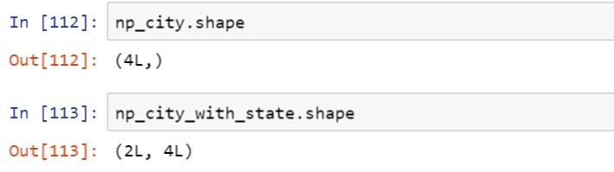
Classes and Attributes of ndarray: .shape
Numpy’s array class is ndarray , also referred to as numpy.ndarray . Th e attrib utes of ndarray are:
The shape tup le of both the arrays ind ica te their size a long each d im ension.
ndarray.nd im
ndarray.shape
ndarray.size
ndarray.dtype
Concept
Example

Slide 16
Classes and Attributes of ndarray: .size
Numpy’s array class is ndarray , also referred to as numpy.ndarray . Th e attrib utes of ndarray are:
It gives the total num ber of e lem ents in the array. It is equal to the product of the e lem ents of the shape tup le .
ndarray.nd im
ndarray.shape
ndarray.size
Array conta in s 6 e lem ents
Array conta in s 12 e lem ents
Arra y a = (2, 3) Size = 6
Arra y b = (2, 3, 2) Size = 12
ndarray.dtype
Concept
Example

Slide 17
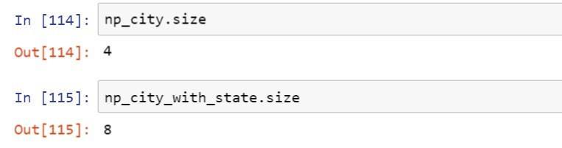
Classes and Attributes of ndarray: .size
Numpy’s array class is ndarray , also referred to as numpy.ndarray . Th e attrib utes of ndarray are:
Lo ok at the exam ples to see how the shape tuples of the arrays are used to ca lcu late the ir s ize .
ndarray.nd im
ndarray.shape
ndarray.size
ndarray.dtype
Concept
Example

Slide 18

Classes and Attributes of ndarray: .dtype
Numpy’s array class is ndarray , also referred to as numpy.ndarray . Th e attrib utes of ndarray are:
It’s an object that describes the type of the e lem ents in the array. It can be created or specified using Python.
ndarray.nd im
ndarray.shape
ndarray.size
Array conta in s in tegers
Arra y a = [3, 7, 4]
[2, 1, 0]
Array conta in s floats
Arra y b = [1.3, 5.2, 6.7]
[0.2, 8.1, 9.4]
[2.6, 4.2, 3.9]
[7.8, 3.4, 0.8]
ndarray.dtype
Concept
Example

Slide 19
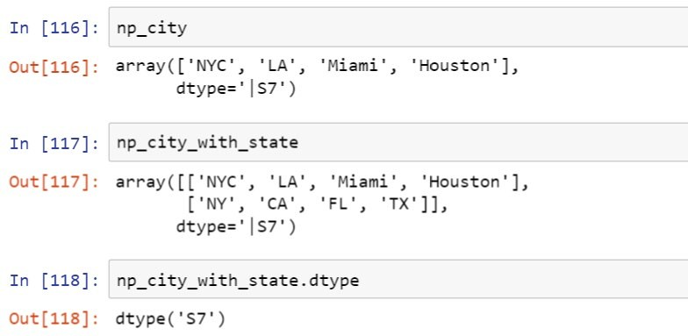
Classes and Attributes of ndarray: .dtype
Numpy’s array class is ndarray , also referred to as numpy.ndarray . Th e attrib utes of ndarray are:
Both the arrays are of string Houston .
data type (dtype) and the longest string is of length 7, wh ich is
ndarray.nd im
ndarray.shape
ndarray.size
ndarray.dtype
Concept
Example

Slide 20
Basic Operations
Using the following operands, you can easily apply various mathematical, logical, and comparison operations
on an array.
Mathematical Operations
Logical Operations
Comparison Operations
Addition | +
Subtraction | -
Multiplication | *
Division | /
Exponentiation | **
And | &
Or | |
Not | ~
Greater | >
Greater or equal | >=
Less | <
Less or equal | <=
Equal | ==
Not equal | !=

Slide 21
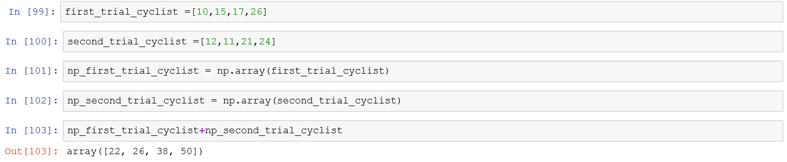
Basic Operations: Example
NumPy uses the indices of the elements in each array to carry out basic operations. In this case, where we are looking at a dataset of four cyclists during two trials, vector addition of the arrays gives the required output.
First trial Second trial
Total distance
Array (First trial)
Array (Second trial)
Array (Total distance)
10 | 15 | 17 | 26
+
12 | 11 | 21 | 24
=
22 | 26 | 38 | 50
0
1
2
3
0
1
2
3
Index
Index
Vector addition

Slide 22
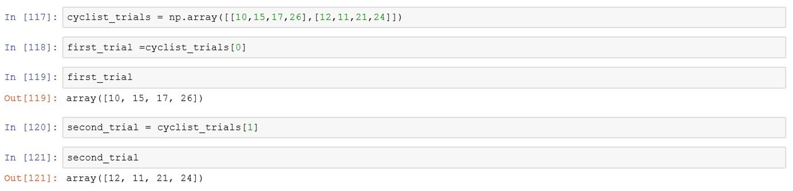
Accessing Array Elements: Indexing
You can access an entire row of an array by referencing its axis index.
1st set data
2nd set data
Create 2D array using cyclist trial data shown earlier
First trial data
Second trial data
2D array conta in in g cyclis ts’ data
Firs t tria l (axis 0)
Second tria l (axis 1)
10 | 15 | 17 | 26
12 | 11 | 21 | 24

Slide 23
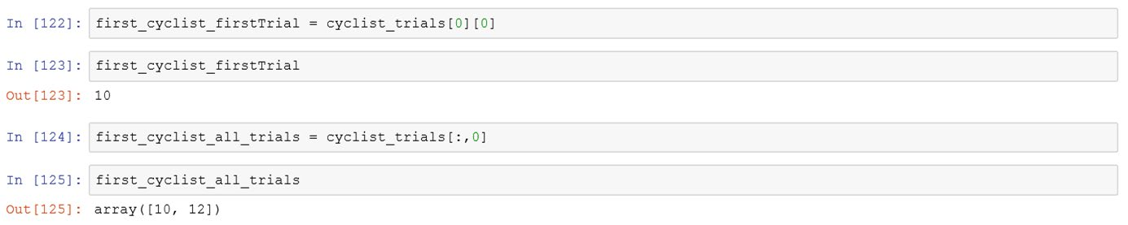
Accessing Array Elements: Indexing
You can refer the indices of the elements in an array to access them. You can also select a particular index of more
than one axis at a time.
First cyclist: first trial data
First cyclist: all trial data
(Use : to select all the rows of an array)
(0, 0)
(0, 1)
(0, 2)
(0, 3)
(0, 0)
(0, 1)
(0, 2)
(0, 3)
Cyclist 1, first trial data
10 | 15 | 17 | 26
12 | 11 | 21 | 24
Cyclist 1, all trials data
10 | 15 | 17 | 26
12 | 11 | 21 | 24
(1, 0)
(1, 1)
(1, 2)
(1, 3)
(1, 0)
(1, 1)
(1, 2)
(1, 3)

Slide 24
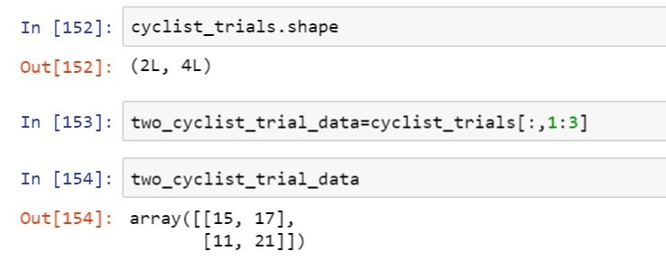
Accessing Array Elements: Slicing
Use the slicing m e thod to access a range of values with in an array.
Shape of the array
10 | 15 | 17 | 26
Shape of the array
2 rows
12
11
21
24
4 colum ns
Slicin g |  | the | array
10 | 15 | 17 |  | 26
12 | 11 | 21 |  | 24
Use ‘:’ to se le ct a ll rows
Slicing the array data [ : , 1 : 3] where 1 is inclusive but 3 is not
0 | 1 | 2 | 3
Startin g index (1)
End ing index (2)

Slide 25

Activity: Slice It!
Select any two elements from the array to see how the statement required to slice the range changes.
Rules of the Game
Choose the first e lem ent of the range. Th en, choose the e lem ent that ends the range.
See how the values in the statem ent change according to your choices.
Re fresh to try again.
5 | 8 | 10 | 21
Select any two elements from the array.

Slide 26
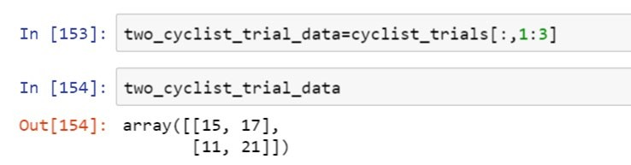
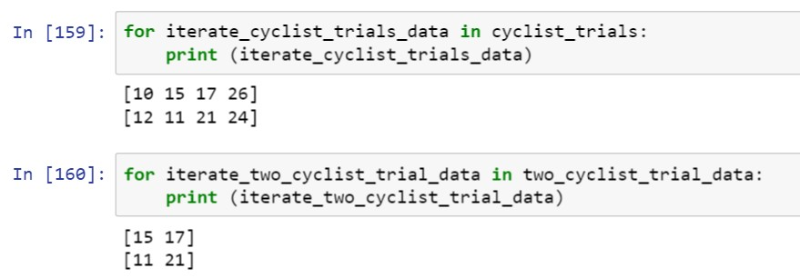
Accessing Array Elements: Iteration
Use the iteration method to go through each data element present in the dataset.
Iterate with for loop through entire dataset
Iterate with for loop
through
the two cyclist datasets

Slide 27
Indexing with Boolean Arrays
Boolean arrays are useful when you need to select a dataset according to set criteria.
True
False

Slide 28
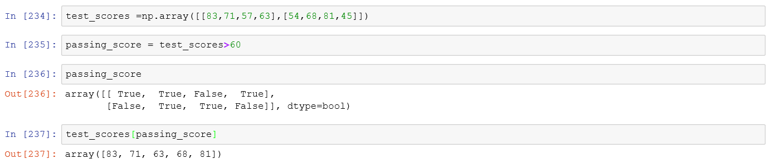
Indexing with Boolean Arrays
Here, the original dataset contains test scores of two students. Yo u can use a Boolean array to choose on ly the scores that are above a given va lu e .
Te st scores
Student 1
Student 2
Te st score > 60
83 | 71 | 57 | 63
54 | 68 | 81 | 45
83 | 71 | 57 | 63
54 | 68 | 81 | 45
Te st 1
Te st 2
Test 3
Te st 4
Setting the passing score
Shows data e lem ents wh ich fit the criteria (Boolean array)
Send passing score as an argum ent to test scores ob je ct

Slide 29

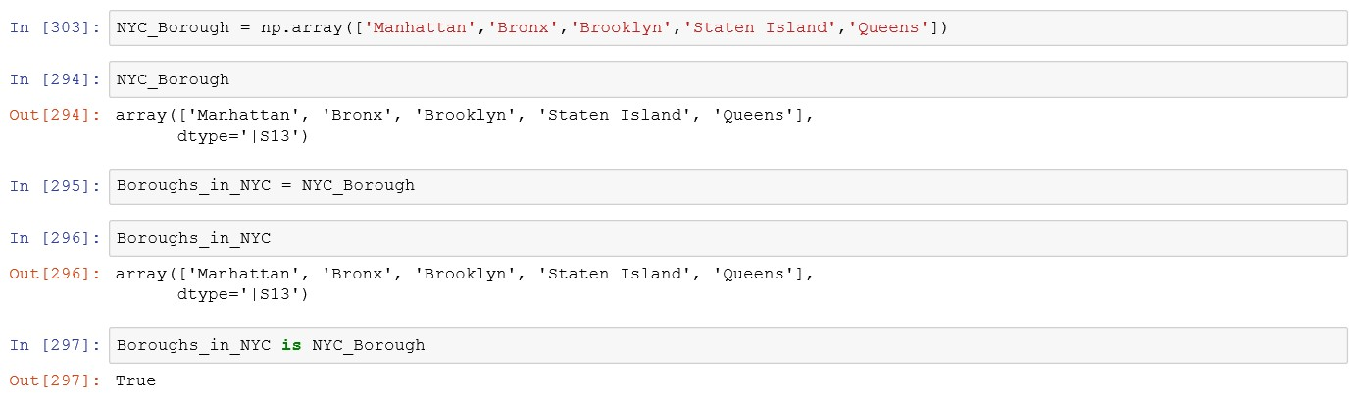


Copy and Views
When working with arrays, data is copied into new arrays only in some cases. Following are the three possible scenarios:
Simple Assignments | In this method, a variable is directly assigned the value of another variable. No new copy is made.
Original dataset View/Shallow Copy
Deep Copy | Assigned dataset Shows both objects are the same

Slide 30

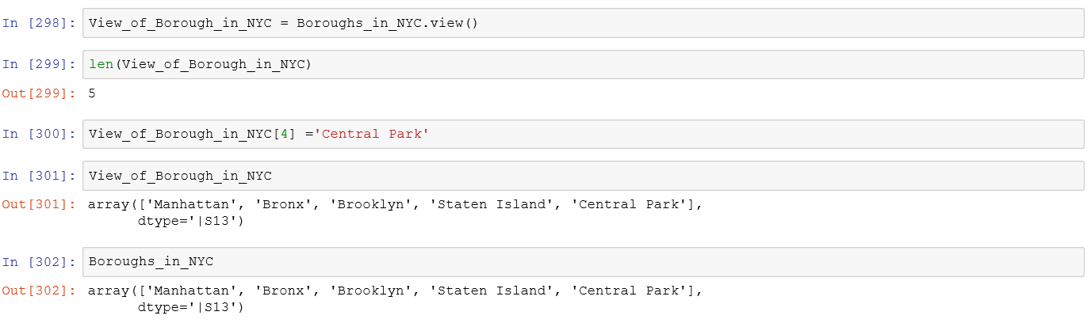


Copy and Views
Simple Assignments
A view, also referred to as a shallow copy, creates a new array object.
Original dataset
View/Shallow Copy
Change value in view object
Deep Copy
Original dataset changed

Slide 31

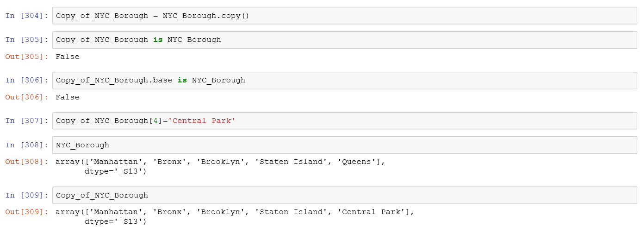


Copy and Views
Simple Assignments
Copy is also called deep copy because it entirely copies the original dataset. Any change in the copy will not affect the original dataset.
Shows copy and original object are different
View/Shallow Copy
Shows copy object data is not owned by the original dataset
Change value in copy
Deep Copy
Copy object changed
Original dataset retained

Slide 32

Universal Functions (ufunc)
NumPy provides useful mathematical functions called Universal Functions. These functions operate element an array, producing another array as output. Some of these functions are:
-wise on
sqrt function provides the square root of every element in the array.
sqrt
cos function gives cosine values for all elements in the array.
cos
floor
floor function returns the largest integer value of every element in the
array.
exp
exp function performs exponentiation on each element.

Slide 33
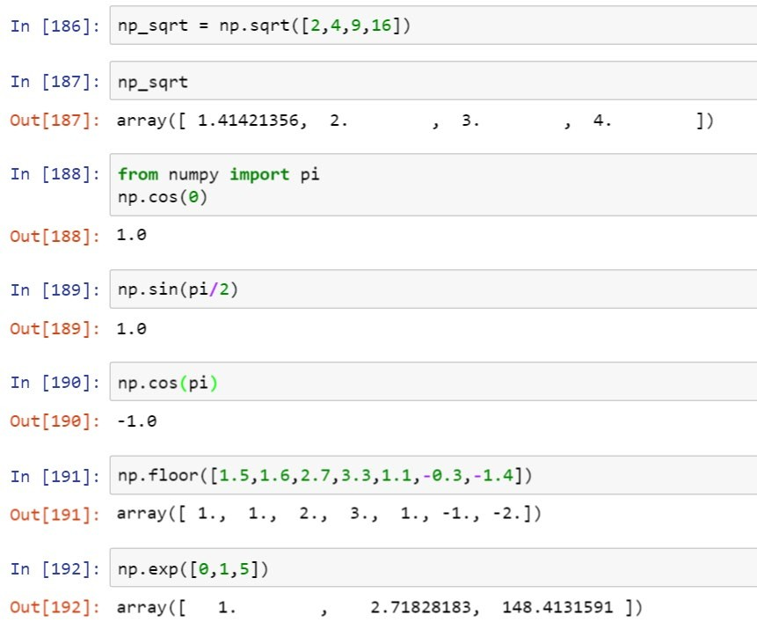
Ufunc: Examples
Numbers for which square root will be calculated
Square root values Import pi*
Trigonometric functions
Return the floor of the input element wise
Exponential functions for complex mathematical calculations

Slide 34
Shape Manipulation
You can use certain functions to manipulate the shape of an array.
The shape of an array can be changed according to the requirement using the NumPy library functions.
1 | 2 | 3
4 | 5 | 6
7 | 8 | 9
1 | 2 | 3 | 4 | 5 | 6 | 7 | 8 | 9
1
4
7
2
5
8
3
6
9
Arra y shape m an ipu la tion m e thods
Data Wranglin g

Slide 35
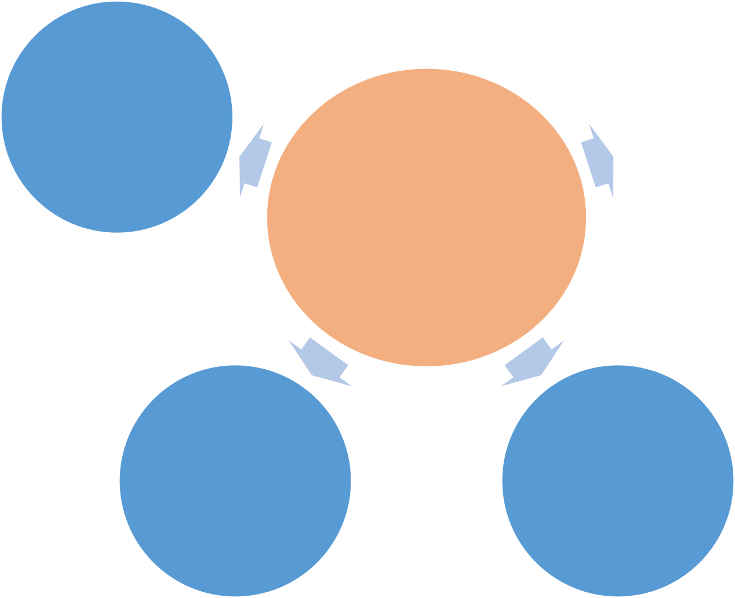
Shape Manipulation
Some common methods for manipulating shapes are:
Flatten
Split
Resize
Shape Manipulation
Stack
Reshape

Slide 36
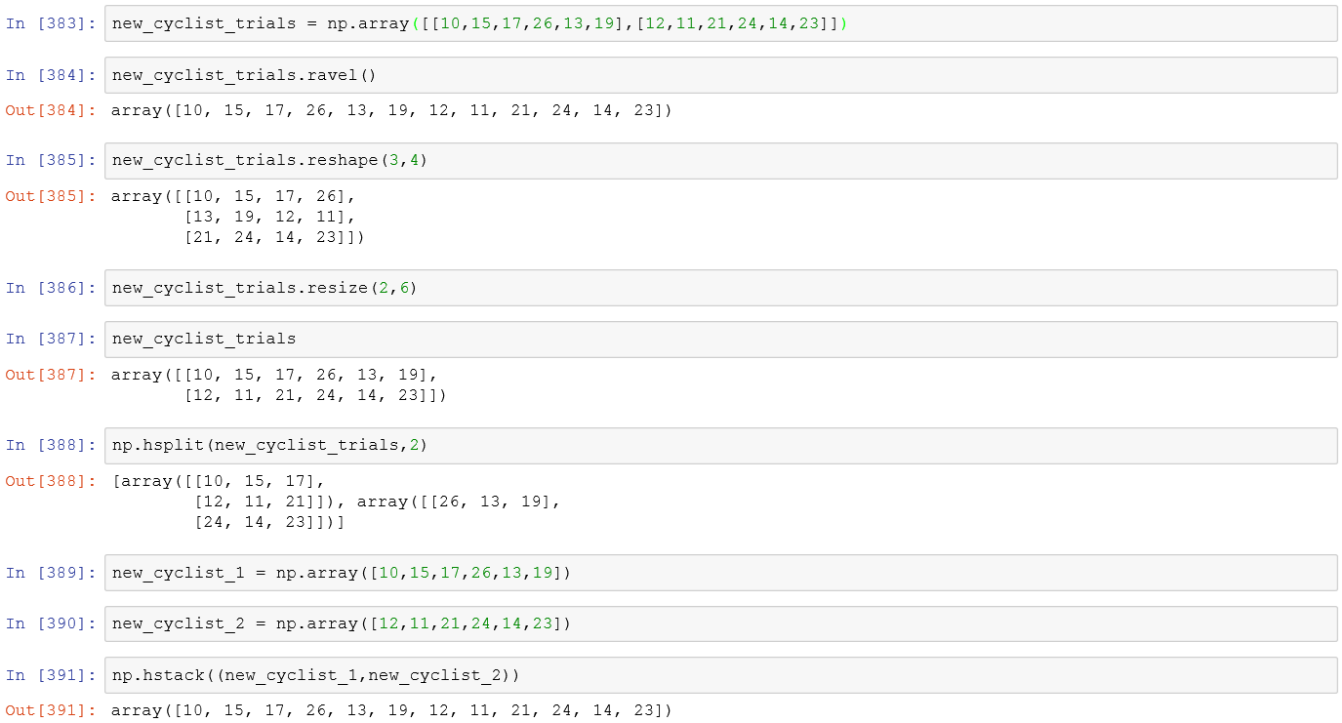
Shape Manipulation: Example
You can use certain functions to manipulate the shape of an array to do the following:
Flattens the dataset
Changes or reshapes the dataset to 3 rows and 4 columns
Resizes again to 2 rows and 6 columns
Splits the array into two
Stacks the arrays together

Slide 37
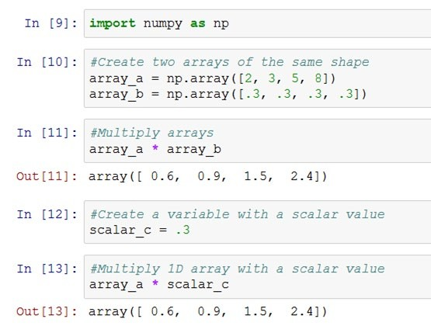
Broadcasting
NumPy uses broadcasting to carry out arithmetic operations between arrays of different shapes. In this method, NumPy automatically broadcasts the smaller array over the larger array.
array_a
Elem ent-wis e m u ltip lica tio n
array_b array_a
2 | 3 | 5 | 8
0.3 | 0.3 | 0.3 | 0.3
2 | 3 | 5 | 8
Broadcasting
0.3
sca lar_c
If the shape doesn ’t m atch with array_a , num py doesn ’t have to create copies of sca lar va lu e .
In stead, broadcast sca lar va lu e over the entire array to find the product.

Slide 38
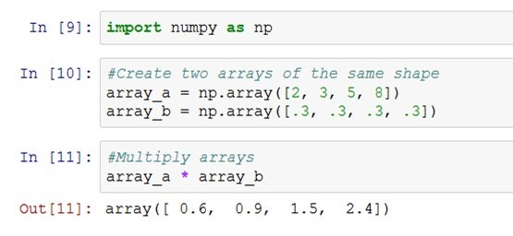
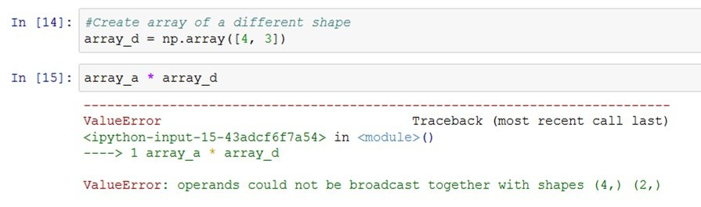
Broadcasting: Constraints
Though broadcasting can help carry out mathematical operations between different
to certain constraints as listed below:
-shaped arrays, they are subject
When NumPy operates on two arrays, it compares their shapes element -wise. It finds these shapes compatible only if:
Their dimensions are the same or
One of them has a dimension of size 1.
If these conditions are not met, a ValueError is thrown, indicating that the arrays have incompatible shapes.

Slide 39
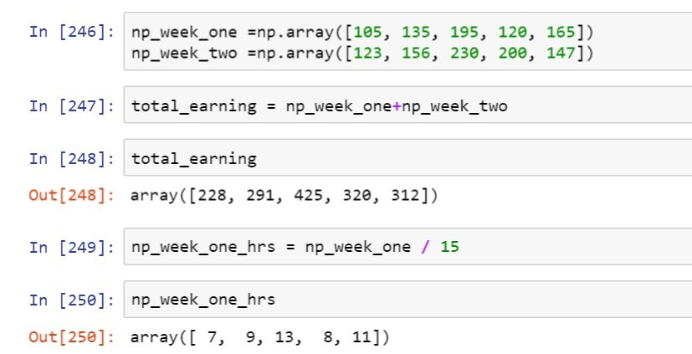
Broadcasting: Example
Let’s look at an example to see how broadcasting works to calculate the number of working hours of a worker per
day in a certain week.
Week one earnings Week two earnings
Element -wise operation
Total earning for 2 weeks
Calculate week one hours Hourly wage
Number of working hours per day in week one

Slide 40
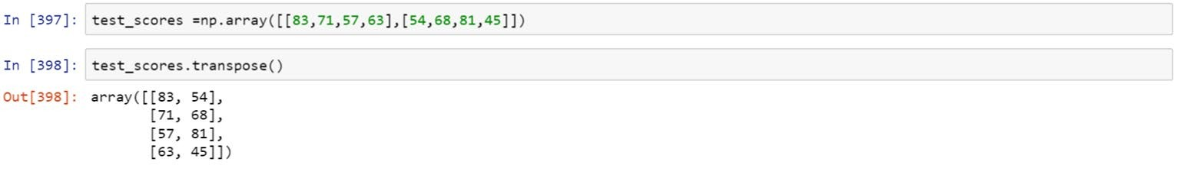
Linear Algebra: Transpose
NumPy can carry out linear algebraic functions as well. The transpose()
columns, and vice -versa.
function can help you interchange rows as
transpose()
Axis 1
Axis 1
83 | 71 | 57 | 63
54 | 68 | 81 | 45
Axis 0
Axis 0

Slide 41
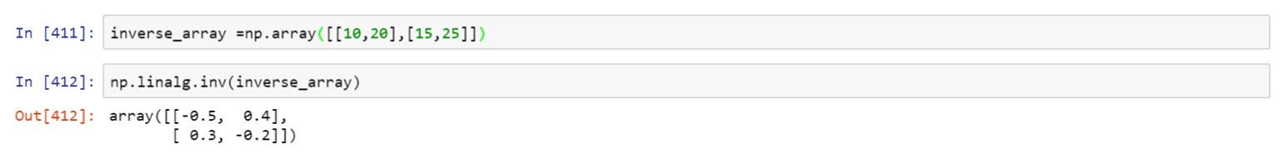
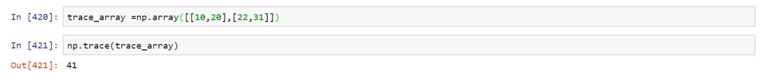
Linear Algebra: Inverse and Trace Functions
Using NumPy, you can also find the inverse of an array and add its diagonal data elements.
np.linalg.inv()
In verse of the given array
* Can be applied only on a square matrix
np.trace()
Sum of diagonal e lem ents 10 and 31

Slide 42
Country GDP
Evaluate the dataset containing the GDPs of different countries to:
Find and print the nam e of the country with the h ighe st GDP
Find and print the nam e of the country with the lowest GDP
Print out text and input values ite ratively
Print out the entire list of the countries with their GDPs
Print the highest GDP value, lowest GDP value, m ean GDP value, standardized GDP value, and the sum of a ll the GDPs

Slide 43
Olympic 2012 Medal Tally
Evaluate the dataset of the Summer Olympics, London 2012 to:
Find and print the nam e of the country that won m axim um gold m edals
Find and print the countries who won m ore than 20 gold m edals
Prin t the m edal ta lly
Print each country nam e with the correspond ing num ber of gold m edals
Print each country nam e with the total num ber of m edals won

Slide 44
Knowledge Check
Which of the following arrays is valid?
1
a.
[1, 0.3, 8, 6.4]
b.
[“Lucy”, 16, “Susan”, 23, “Carrie”, 37]
c.
[True, False, “False”, True]
d.
[3.14j, 7.3j, 5.1j, 2j]

Slide 45
Knowledge Check
Which of the following arrays is valid?
1
a.
[1, 0.3, 8, 6.4]
b.
[“Lucy”, 16, “Susan”, 23, “Carrie”, 37]
c.
[True, False, “False”, True]
d.
[3.14j, 7.3j, 5.1j, 2j]
The correct answer is
d
A NumPy ndarray can hold only a single data type, which makes it homogenous. NumPy supports integers, floats, Booleans, and even complex numbers. Of all the options provided, only the array containing complex numbers is homogenous. All the other options contain more than one data type.

Slide 46
Knowledge Check
Which function is most useful to convert a multidimensional array into a one dimensional array?
-
2
a.
ravel()
b.
reshape()
c.
resize() and reshape()
d.
All of the above

Slide 47
Knowledge Check
Which function is most useful to convert a multidimensional array into a one dimensional array?
-
2
a.
ravel()
b.
reshape()
c.
resize() and reshape()
d.
All of the above
The correct answer is
a
The function ravel() is used to convert a multidimensional array into a one -dimensional array. Though reshape() also functions in a similar way, it creates a new array instead of transforming the input array.

Slide 48
Knowledge Check
The np.trace() method gives the sum of .
3
a.
the entire array
b.
the diagonal elements from left to right
c.
the diagonal elements from right to left
d.
consecutive rows of an array

Slide 49
Knowledge Check
The np.trace() method gives the sum of .
3
a.
the entire array
b.
the diagonal elements from left to right
c.
the diagonal elements from right to left
d.
consecutive rows of an array
The correct answer is
b
The trace() function is used to find the sum of the diagonal elements in an array. It is carried out in an incremental order indices. Therefore, it can only add diagonal values from left to right and not vice versa.
of the

Slide 50
Knowledge Check
The function np.transpose() when applied on a one dimensional array gives .
4
a.
a reverse array
b.
an unchanged original array
c.
an inverse array
d.
all elements with zeroes

Slide 51
Knowledge Check
The function np.transpose() when applied on a one dimensional array gives .
4
a.
a reverse array
b.
an unchanged original array
c.
an inverse array
d.
all elements with zeroes
The correct answer is
b
Transposing a one -dimensional array does not change it in any way. It returns an unchanged view of the original array.

Slide 52
Key Takeaways
You are now able to:
Explain NumPy and its importance
Discuss the basics of NumPy, including its fundamental objects Demonstrate how to create and print a NumPy array
Analyze and perform basic operations in NumPy
Utilize shape manipulation and copying methods Demonstrate how to execute linear algebraic functions
Build basic programs using NumPy

